Slide 1
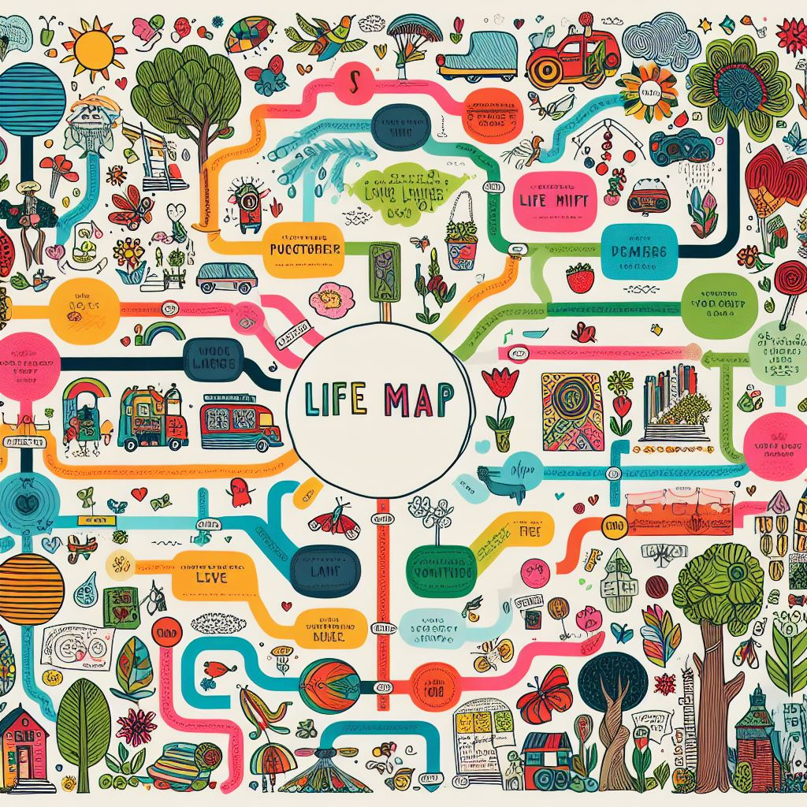
My Life Map

Slide 2
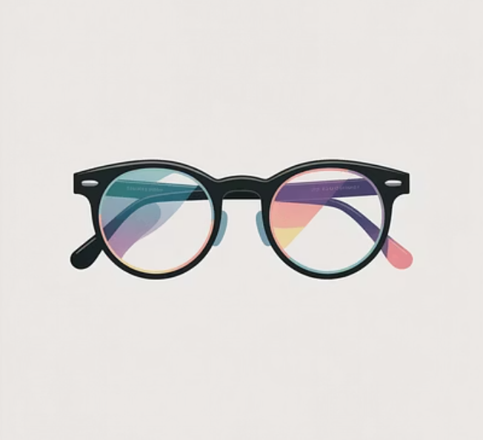
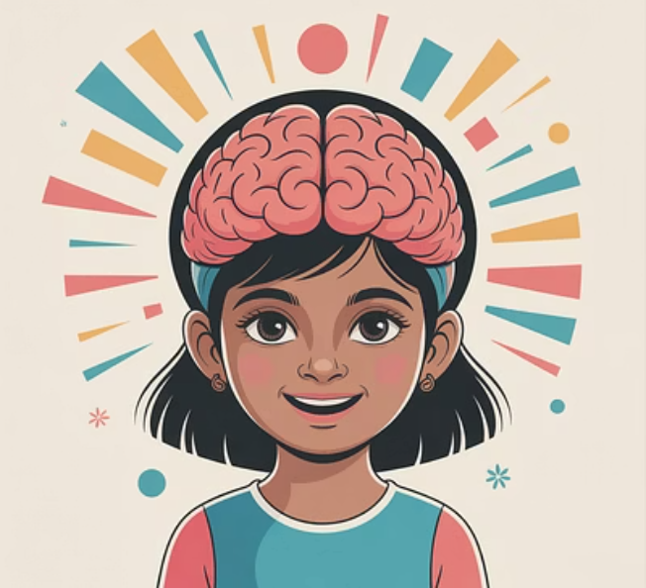



A Visual Journey Through Key Life Events
Turns out I needed glasses.
That changed my life.
I could finally see everything clearly.
My grades went back up and everyone was happy.
I was considered really smart
when I was a kid back in India. Got all As.
Parents very proud.
In third grade I suddenly
started failing everything.
My teacher called my parents.
My parents got mad but then
took me to the eye doctor to see if
that was the problem.

Slide 3
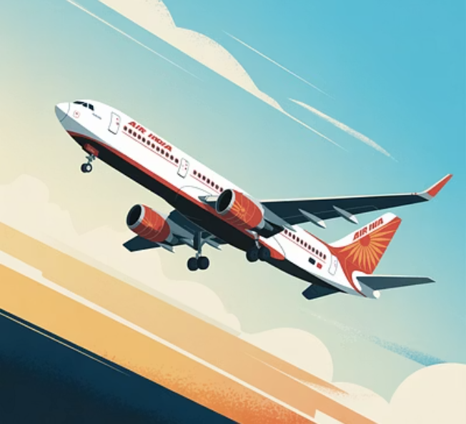
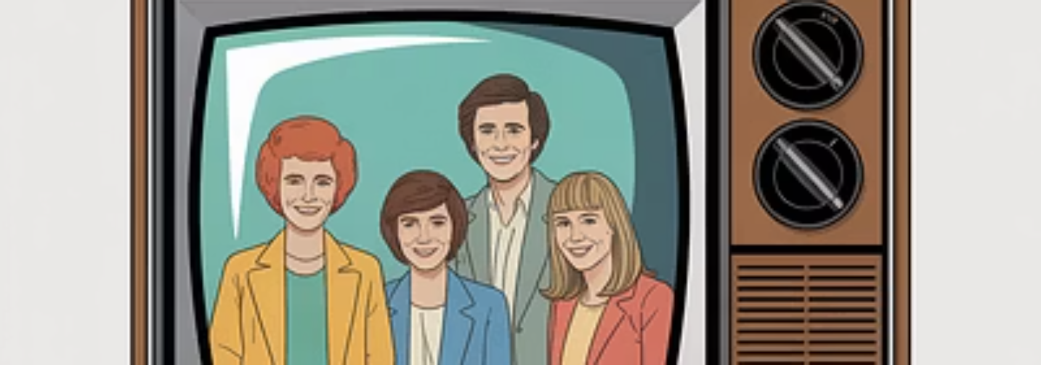
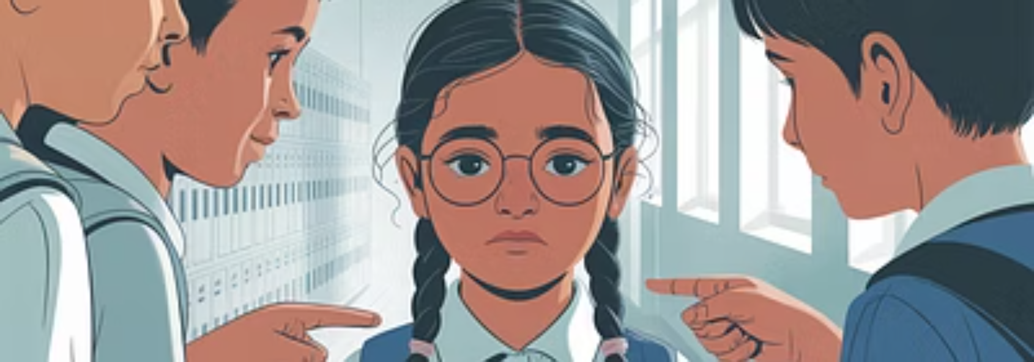
A Visual Journey Through Key Life Events
We moved to Chicago when I was 9. Everything was exciting and new but a little scary. No grandparents or cousins to visit or play with.
My brothers and I decided we would learn how to be like everyone else. We would come home from school and watch all the tv shows and practice how to
talk like the kids on tv. We convinced my mom to buy us
American clothes so we would look the same. Eventually we learned how to fit in. It felt like we had to hide our language and our culture and our traditions so we could be the same.
My brothers and I had accents. The kids at
school would tease us and make fun of us. I stopped talking in class. Everyone thought I couldn’t do the work but I just didn’t want to be made fun of.

Slide 4
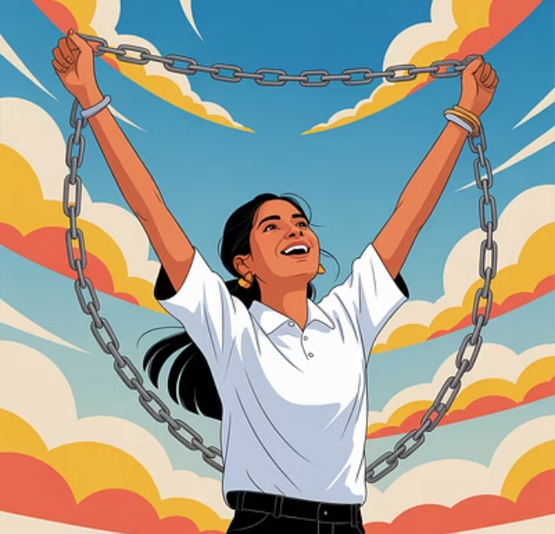
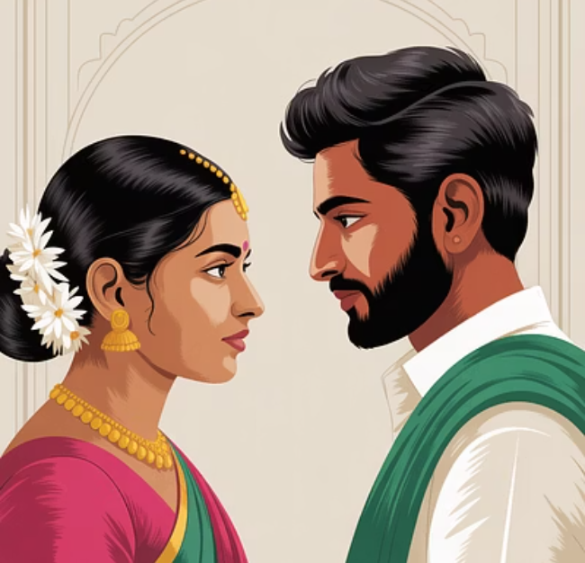


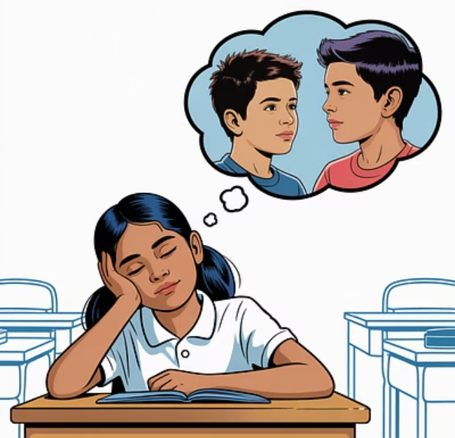
When I was in high school I was very boy crazy and started failing my classes again.
I was free and finished my Ph.D. and became a teacher and then a professor at Fresno State. I wrote this curriculum and work with schools to help kids write their stories and get their voices heard and become authors.
My mom decided I needed to get married. I was only 17 and didn’t even have a high school diploma yet.
My husband was cruel and violent.
My education gave me strength and the knowledge to know better. I finally got the courage to say no and get a divorce
It was hard to be married so young and take care of the house and cook but I studied hard anyway and got my GED. Then I continued and went to college while raising my son.

Slide 5

I met and married a very nice man.
He’s a music teacher and plays the saxophone and is
kind and funny. Now my life is how I hoped it would be. I teach, I write, I travel and enjoy nature, and get to work with all of you!

